Slide 1
Unit 1. Computing Environments
1.4 Processors
logic gates and logic circuits
the basic Von Neumann model of a computer system
the purpose and role of the registers
the purpose and role of the arithmetic logic unit (ALU), control unit (CU), system clock and immediate access store (IAS)
functions of the bus lines
factors affecting computer performance (such as processor type, bus width, clock speeds, cache memory and use of core processors)
the connection of computers to peripheral devices such as Universal Serial Bus (USB), high definition multimedia interface (HDMI)

Slide 2
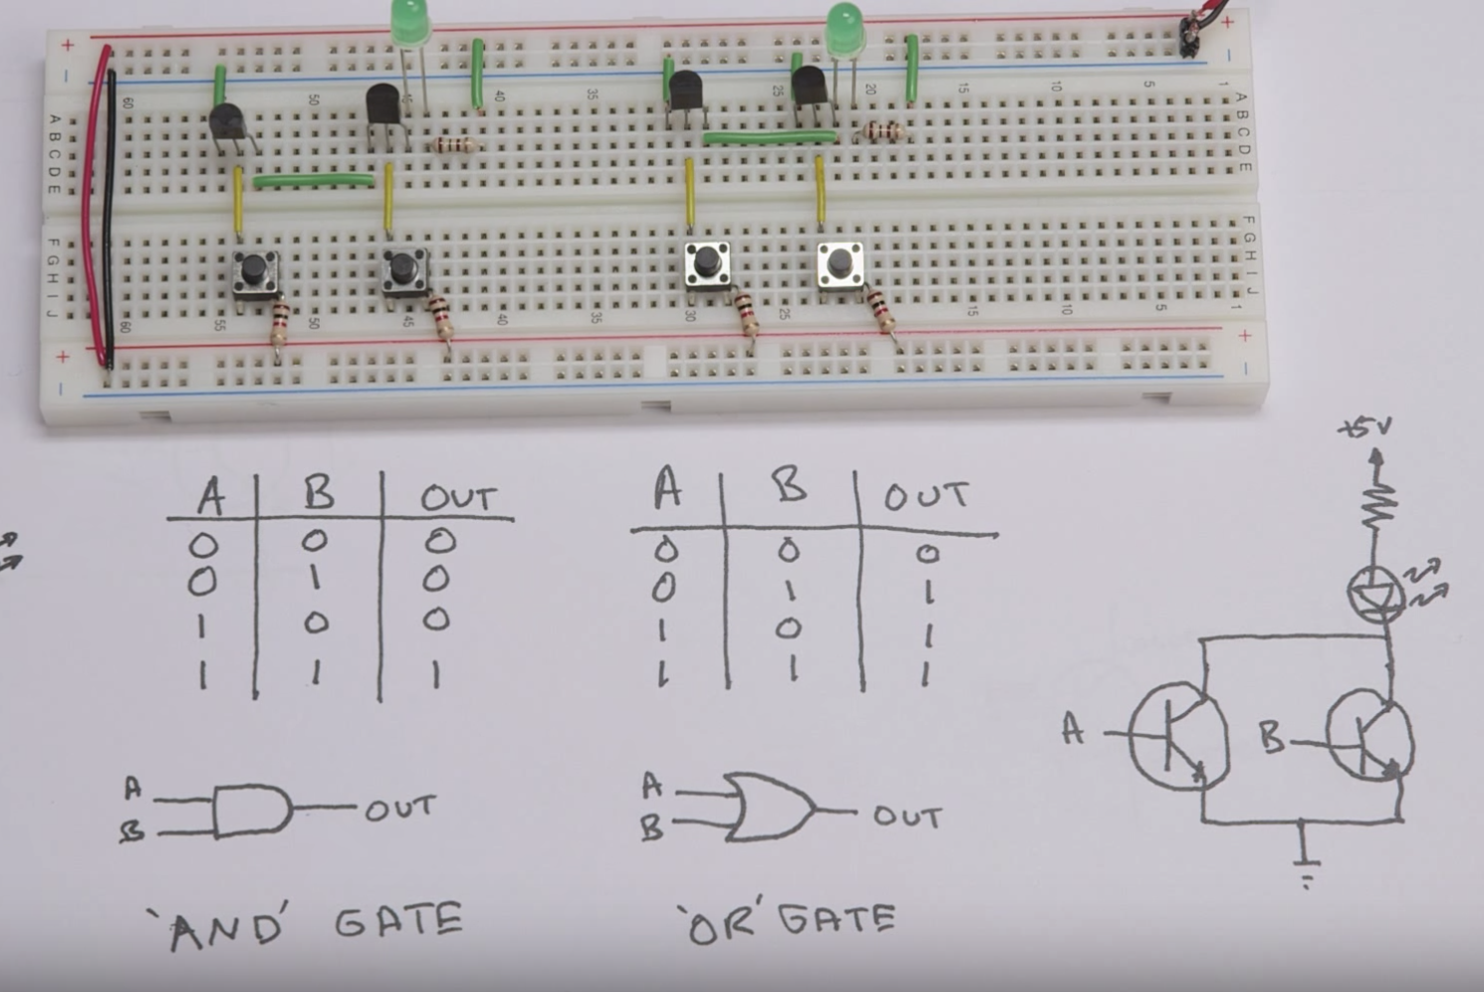
Logic Gates
Our powerful computers now require billions of gates, so their actual size is very small. A mac can have 5.6 billion transistors that are just 14 nanometers wide.
A, B are Transistors

Slide 3
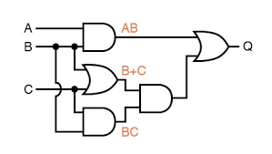
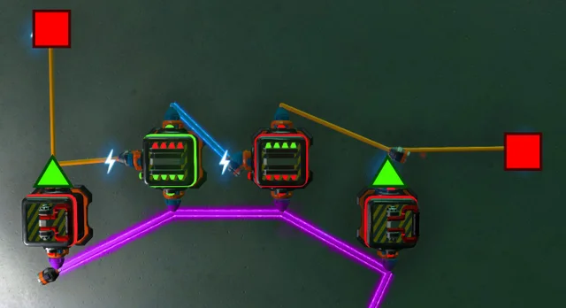
Logic Circuits

Slide 4
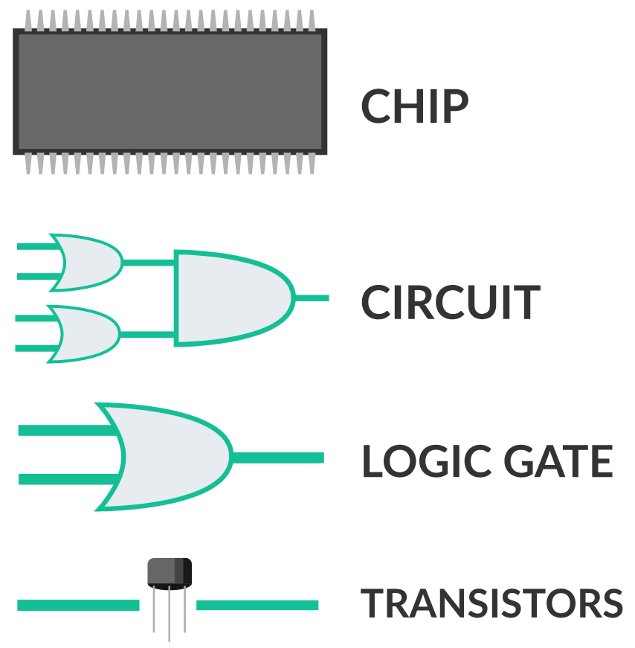
Processors – Chip
The Central Processing Unit (CPU) is the "brain" of the computer. It executes instructions (from software) and tells other components what to do. The Intel Pentium is a popular processor for IBM-PCs. The PowerPC is a popular processor for Macintoshes.
There are 2 parts of the CPU: The ALU and Control Unit.
The Arithmetic Logic Unit (ALU) performs arithmetic operations (such as addition and subtraction) and logical operations (such as comparing two values).
An optional math co-processor can take the place of the ALU. It performs the same operations, only it is faster.
The Control Unit deciphers and carries out instructions. Different CPUs have different types of instructions, so software made for one type of CPU will not run on other kinds.
The word size denotes how many bits of data a CPU can process at once. 64 bits is the standard word size for CPU's used in personal computers today. The higher the word size, the faster a CPU can execute instructions.

Slide 5
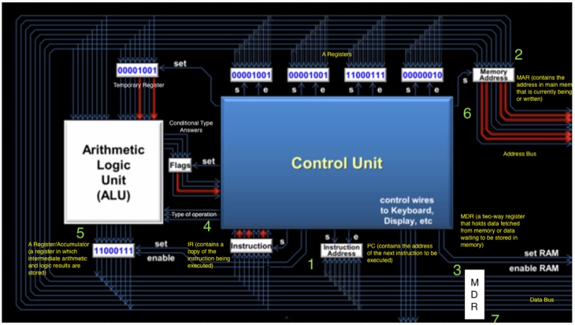
Processors – Chip
The System Clock is an "electrical pulse generator" that sends out a pulse of electricity at regular intervals. The electronic components of the computer need these electric pulses in order to perform work. The more pulses sent out by the system clock, the faster the computer. The first personal computers had clock speeds of 8 MHz (8 million pulses per second); today's PC's have clock speeds greater than 3.2 GHz (3.2 billion pulses per second).
Bus Lines are "electrical data roadways" (i.e. wires) through which bits of information are transmitted between the CPU and other components. The bus size denotes how many bits can be transmitted at once. In general, this should be the same as the CPU word size.

Slide 6
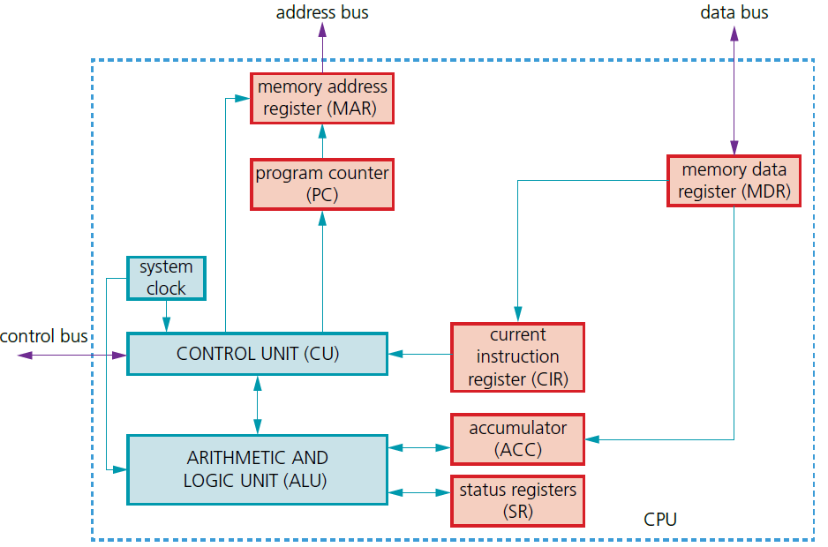
Von Neumann Model
Von Neumann Architecture:
a central processing unit (CPU or processor)
a processor able to access the memory directly
computer memories that could store programs as well as data
stored programs made up of instructions that could be executed in sequential order
The accumulator (ACC) is a temporary register used when carrying out ALU calculations. Registers can be general purpose or special purpose. General purpose registers hold data that is frequently used by the CPU or can be used by the programmer when addressing the CPU directly. Special purpose registers have a specific function within the CPU and hold the program state.

Slide 7
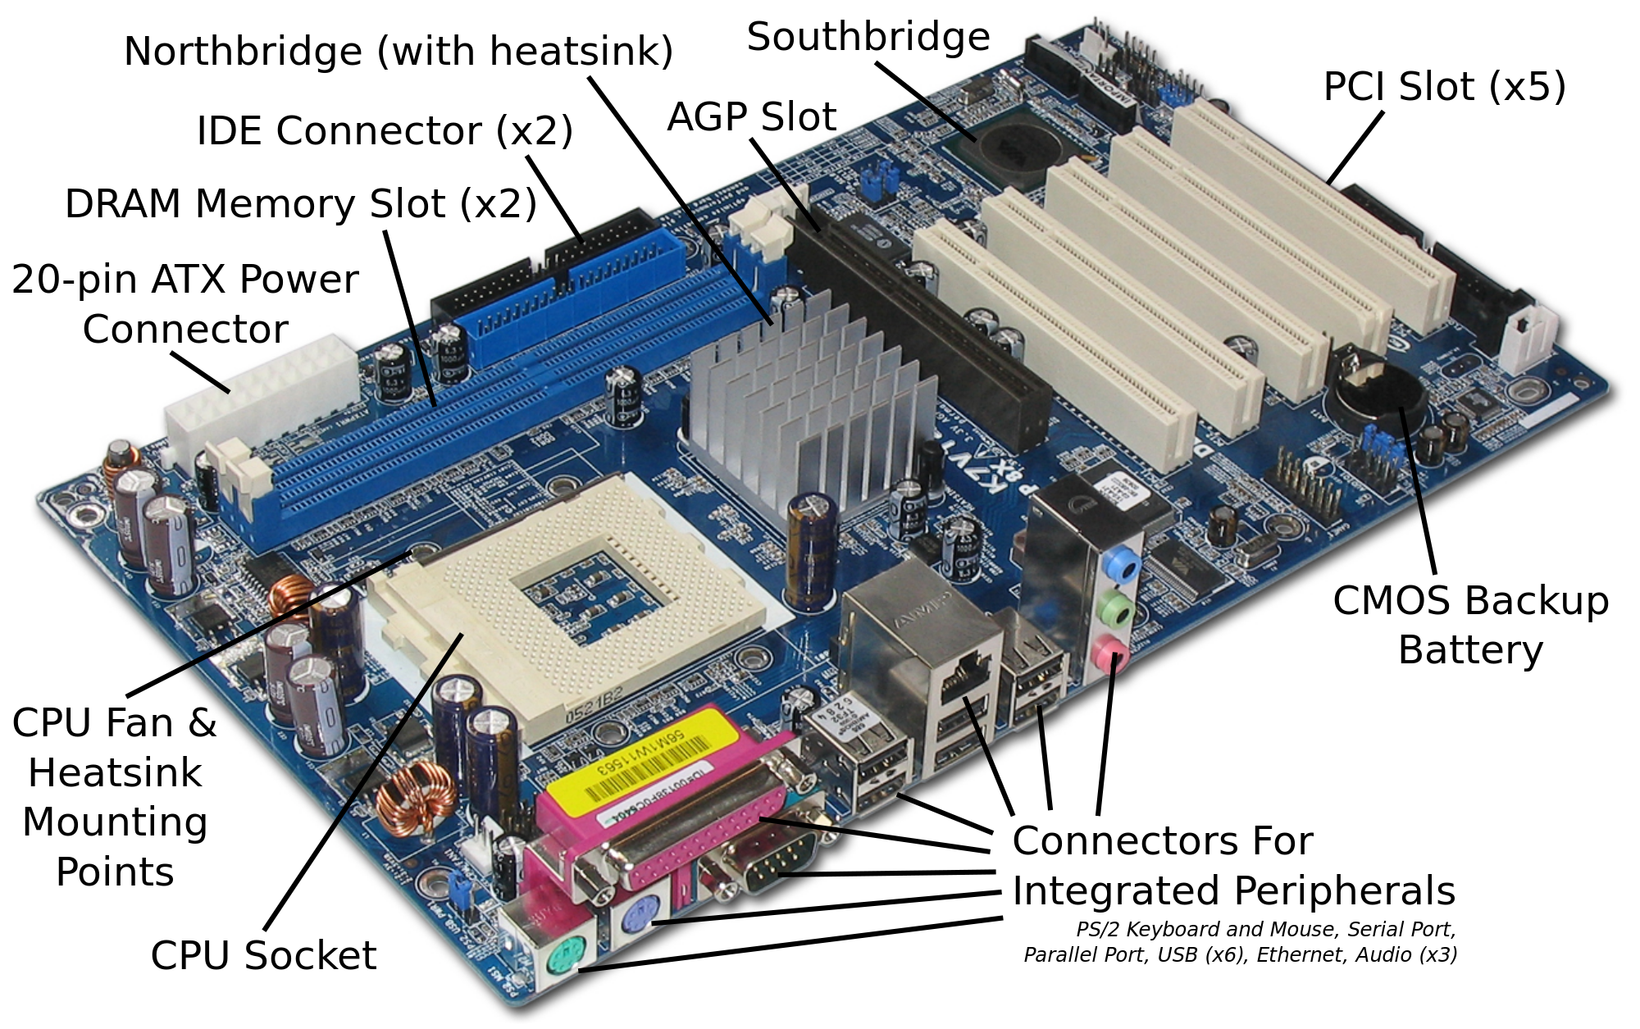
Motherboard and Computer Ports
The Motherboard is the main circuit board for the computer, containing both soldered, nonremovable components along with sockets or slots for components that can be removed. The motherboard holds the CPU, RAM and ROM chips, etc.
Universal Serial Bus (USB) ports are much faster than serial or parallel ports and allow multiple devices to be connected to the same port.
High-definition multimedia interface (HDMI) ports allow output (both audio and visual) from a computer to an HDMI-enabled device. They support high definition signals (enhanced or standard).

Slide 8
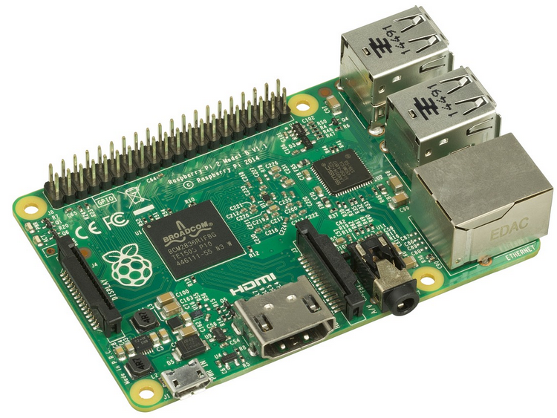

Simple Microcomputers
– Raspberry Pi and Arduino
https://www.khanacademy.org/computing/computers-and-internet/xcae6f4a7ff015e7d:computers/xcae6f4a7ff015e7d:computer-components/a/exploring-microcomputers

Slide 9
Practice Questions
https://www.khanacademy.org/computing/computers-and-internet/xcae6f4a7ff015e7d:computers/xcae6f4a7ff015e7d:computer-components/e/input--cpu--memory--and-output

